Slide 1
Low-level detection of language-level data races with LARD ASPLOS 2014
Benjamin P. Wood, Luis Ceze, Dan Grossman
University of Washington
{bpw,luisceze,djg}@cs.washington.edu
(slides by Ariel Eizenberg, <first.last>@gmail.com)

Slide 2
Introduction DATA RaceS
A data race is a pair of accesses to the same memory location by different threads where at least one access is a write and no synchronization orders the two accesses
A data race detector is sound and complete if it misses no true data races and reports no false data races in an observed execution
A data race detection tool can be implemented at
Language level - detects data races between accesses in the high-level language abstraction
FastTrack (Java)
Low-level – analyzes virtual memory accesses in the instruction set architecture and stores access history for virtual memory locations
Allows for improved performance using hardware accelerations and is not tied to a specific software system
RADISH, Aikido

Slide 3
Introduction Low-Level Races ≠Language-Level Races
Memory accesses/synchronization in services like GC are not based on explicit user code
False detection of races when using low-level detection
Some low-level memory accesses implement language-level synchronization operations
Synchronization not captured fully by low-level detection
The allocator/GC reuses or moves objects in memory
Distinct/unrelated objects can share memory - False detection of races where non occur
Missed detections for an object that has moved
No 1-1 relationship between language-level and low-level threads
False or missed races
Thus a low-level race detector for programs written in high-level languages
Will reports false data races
Will miss true data races

Slide 4
BACKGROUND Race detection using vector clocks
The canonical algorithm for race detection uses vector clocks (VC) to represent the happens-before relationship graph
Each thread maintains
A local logical time (LT)
A VC representing the last LT that happened-before the thread’s LT for each thread
Each lock maintains
A VC representing the last LT for each thread that happened-before the last release of the lock
Each memory location maintains
Thread that performed that last write and its LC
For each thread, the LC of the last read
Different synchronization primitives modify the state of the VCs

Slide 5










BACKGROUND Fork and JOIN
${VC}_{t_{2}+1}^{A}[i]=max⁡({VC}_{t_{2}}^{A}[i]$, ${VC}_{t_{2}}^{B}[i]$)
Thread B
$${VC}_{t_{1}}^{B}$$
$${VC}_{t_{2}}^{B}$$
VC copied
VC merged
$$t_{1}$$
Thread A
$${VC}_{t_{1}}^{A}$$
$${VC}_{t_{2}}^{A}$$
$${VC}_{t_{2}+1}^{A}$$
Fork
Join
Time
$$t_{1}$$
$$t_{2}$$
$$t_{2}+1$$

Slide 6







BACKGROUND LOCK AND RELEASE
No other lock op can occur between t₁ and t₂
${VC}_{t_{1+1}}^{T}[i]=max⁡({VC}_{t_{1}}^{T}[i]$, ${VC}_{t_{1}}^{L}[i]$)
Lock L
$${VC}_{t_{1}}^{L}$$
$${VC}_{t_{1}}^{L}={VC}_{t_{2}}^{L}$$
$${VC}_{t_{2}+1}^{T}$$
VC merged
VC copied
Thread T
$${VC}_{t_{1}}^{T}$$
$${VC}_{t_{1}+1}^{T}$$
$${VC}_{t_{2}}^{T}$$
Lock
Release
Time
$$t_{1}$$
$$t_{2}$$
$$t_{2}+1$$

Slide 7



BACKGROUND RACE detection (1) – Read and writes
Check ${VC}_{t_{2}}^{B}[A]≥t1$
Last Write = (A : t₁)
Write
Read
Thread A
$${VC}_{t_{1}}^{T}$$
$${VC}_{t_{1}+1}^{T}$$
Thread B
Time
$$t_{1}$$
$$t_{2}$$

Slide 8

BACKGROUND RACE detection (2) –writes
Check ${∀Ti, VC}_{t_{2}}^{B}[Ti]≥ti$
Last Read for T_{i} = t_{i}
Read
Write
Thread T_{i}
$${VC}_{t_{1}}^{T}$$
$${VC}_{t_{1}+1}^{T}$$
Thread B
Time
$$t_{2}$$

Slide 9
LARD BASICS
Abstract data-race detection operations to high-level execution environments
Modify the high-level language implementation:
Distinguish between user code and runtime operations
Maintain the mapping between high-level memory and virtual memory
Maintain the mapping between high-level threads and kernel threads
Operation | Prevents | Translation Issue
(Un)tracked access | False races | User vs. system
(Un)tracked sync. | Missed races | User vs. system
Clear history | False races | Memory reuse
Move history | Missed races | Memory movement
Set thread identity | False and missed races | Thread Scheduling
(Table 1 – Page 4)

Slide 10
LARD Memory access
RULE 1
The race detector should track and check only accesses explicit in the source program for races
Example 1
The implementation of locks might be lock-free, using memory reads and writes plus hardware synchronization primitives like fences and atomic CAS
These may race but are “verified” wrt hardware memory model for correct operation
These races should be ignored

Slide 11
LARD Memory access
RULE 1
The race detector should track and check only accesses explicit in the source program for races
Example 2
A concurrent mark-sweep garbage collector traverses the heap while threads continue to mutate it
GC compensates in a safe, algorithm-specific way
A low-level race detector will report a race with between the user code and the GC
The low-level race detector will override the last write information with the GC write, so a true race later can be missed

Slide 12
LARD Synchronization
RULE 2
The race detector should analyze only synchronization explicit in the user program.
Runtime syncs can cause the detector to miss data races in the user code:
the racing accesses appear well-ordered to the low-level race detector
Example
Java View |  | JVM View |  | Race Detector View
Thread 1 | Thread 2 | Thread 1 | Thread 2 | Thread 1 | Thread 2
Write to X
Write to X
Write to X
Time
GC Pause
Sync out
Wait
Resume
Sync in
Sync out
GC Resume
Sync in
Write to X
Write to X
Write to X
(Figure 1 - §3.2 – Page 5)
Missed Race!

Slide 13
LARD Memory allocation
RULE 3
The detector should clear access histories of low-level memory locations atomically with collection/freeing of language-level occupants
Example
Java View |  | JVM View |  | Race Detector View
Thread 1 | Thread 2 | Thread 1 | Thread 2 | Thread 1 | Thread 2
Write to X
Write to X
Write to X
Time
Collect X
new X()
Alloc X
(addr reuse)
Write to X
Write to X
Write to X
(Figure 1 - §3.3 – Page 5)
False Race!

Slide 14
LARD Memory MOVEMENT
RULE 4
The detector should move access histories of low-level memory locations to follow with
language-level memory objects moved by the run-time system
Example
Java View |  | JVM View |  | Race Detector View
Thread 1 | Thread 2 | Thread 1 | Thread 2 | Thread 1 | Thread 2
Write to X
Write to X
Write to X
Time
GC moves X to new address
Write to X
Write to X
Write to Y
(Figure 1 - §3.4 – Page 5)
Missed Race!

Slide 15
LARD Thread identity
RULE 5
The race detector should use language-level thread identities in its analysis
Example 1
Java View |  | JVM View |  | Race Detector View
LL Thread 1 | LL Thread 2 | LL Thread 1 | LL Thread 2 | Kernel Thread
Write to X
Write to X
Time
LL Thread 1
Write to X
LL Thread 2 scheduled
LL Thread 2
Write to X
Write to X
Write to X
Missed Race!

Slide 16
LARD Thread identity
RULE 5
The race detector should use language-level thread identities in its analysis
Example 2
Java View | JVM View | Race Detector View
LL Thread | LL Thread | Kernel Thread 1 | Kernel Thread 2
Write to X
Time
Write to X
Write to X
LL Thread
LL Thread rescheduled
LL Thread
Write to X
Write to X
Write to X
False Race!

Slide 17
Implementation
Java Program
C/C++ Program
…
Language Implementations
Jikes LardVM
GCC+LIBC
…
Extended ISA
LARDx86
Low-Level Abstractable Race Detectors
LARDISH
Accuracy Analysis
…
(Figure 2 – Page 7)

Slide 18
Implementation The Lardx86 ISA
Generated by JIT or compiler
Extends the x86 ISA with:
Tracked instruction for tracked memory accesses
Instruction prefix, access that follows is checked for low-level data races
Low-level race detector must store a VC for each thread
Untracked instruction are never checked for data races
ReadVC+WriteVC instructions to report thread identity
Read and write entries in the low-level race-detector’s per-thread VCs
Thread instruction to report thread identity mapping
ClearHistory+CopyHistory to manipulate histories
In response to memory reuse/movement
Works on memory ranges (up to full pages for implementation simplicity)

Slide 19
Implementation The Lardx86 ISA - ALTERNATIVES
VCs can be hidden from the runtime
The synchronizations primitives reported directly to the low-level detector
Wider interface (atomics, volatiles, custom locks)
More complex - the semantics of the locks are best understood by the runtime, above the ISA
Exposed vs encapsulated access histories
It might be simpler to collocate access histories with the data
This way histories are automatically managed by runtime
Unfeasible in the current hardware race detector (LARDISH)
Uses physical addresses and not virtual address
Will require reverse address translation

Slide 20
Implementation LARDISH hardware race detector
An extension of the RADISH hybrid hardware-software race detector
RADISH optimizes the VC race detection algorithm by caching access histories in the HW data cache
Most accesses can be checked for races purely in hardware
Optimizations ensure that the common case has little latency
A software system handles storage of access histories after cache evictions and context switches

Slide 21
Implementation LARDISH – LARD extensions
Memory access
RADISH checks for races on all memory accesses except stack accesses and accesses in its software manager
Generalized to use LARDx86’s explicit Tracked memory access instructions
ReadVC and WriteVC
Implemented with RADISH’s existing support for tracking and reporting synchronization in libraries
Thread identity
Is identical to a context switch in RADISH, swapping the thread’s VC
Requires eager or lazy flushing of the old thread’s cached access histories to the software manager
SW manager maintains the mapping between processor cores, kernel threads, and language threads
Clear and copy history
Performs tasks similar to context switches or virtual memory paging in RADISH.
Manipulating access histories in the SW manager is straightforward when they are not cached in hardware
Hardware support is need to invalidate or move cached access histories

Slide 22
Implementation The JIKES LARDVM JVM
Jikes LARDVM is a modified version of Jikes RVM (version 3.1.1)
8229 LoCs modified (half for LARD, rest for debugging/profiling, accuracy analysis, …)
Implements accurate data-race detection for Java using LARDx86
Memory tracking
The LARDVM JIT compiler emits Tracked accesses for potentially racing field and array accesses in Java programs
All other accesses are unmarked, thus ignored by the low-level race detector
Includes JVM code like garbage collector write barriers inlined into compiled code
The compiler can skip marking accesses if they are data-race freed (read-only final fields)
Special handling of volatile fields (section 4.2.2 page 9)
Memory management and mapping
The mark-sweep and semispace collectors modified to issue
CopyHistory when moving an object
ClearHistory when reclaiming an object (including after movement)
Issued conservatively for all objects that might have been used accessed

Slide 23
Implementation accuracy analysis
Tool developed for evaluation of different race detection algorithms
Supports selective enable/disable of different features
Tracking all access vs “tracked accesses”
Enable/disable CopyHistory and ClearHistory
Etc’
Table 3 – page 12 in evaluation demonstrates the false/missed races with individual LARD extensions disabled

Slide 24
Evaluation experimental configuration
Benchmarks from Java Grande and DaCapo 9.12
Except for benchmarks that crash on unmodified Jikes RVM or take too long to complete
Replaced Java Grande’s custom racy spin-waiting barriers with data-race-free versions
Execution compared with FastTrack and naïve low-level VC race detector
Unlike FT, LARD instruments the JDK, so it shows racy unsynchronized misuse of JDK data structures missed by FT
Jikes generates 32-bit code, so 64-bit long/double accesses show up as two races in LARD vs one in FT
The naïve detector reports much larger numbers of accesses, most being false races on system level access
The naïve detector misses some true races due to issues like thread mapping and GC operations

Slide 25
Evaluation FALSE and Missed races
Benchmark | FastTrack | LARD | Naïve
Java Grande | 0 | 0 | 124
avrora | 6 | 8 | 129
luindex | 0 | 0 | 745
lusearch | 0 | 0 | 2395
pmd | 3 | 9 | 87
sunflow | 7 | 16 | 123
xalan | 8 | 34 | 149
Table 2 (page 10)
Showing just distinct PCs of data race reports for MS GC

Slide 26
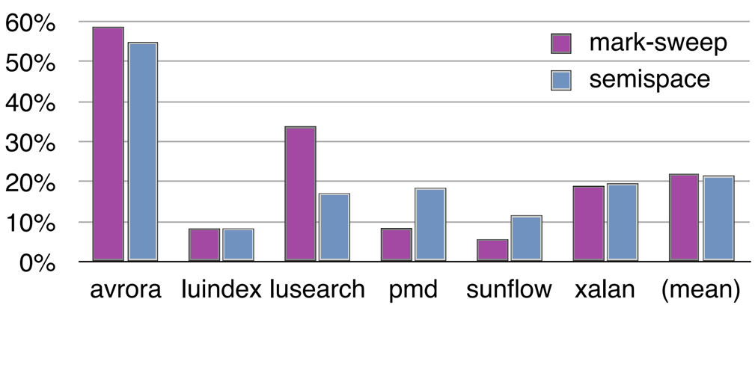
Evaluation PERFORMANCE
Time Overheard normalized to unmodified Jikes RVM on native x86
(Figure 3 – Page 12)

